Slide 1
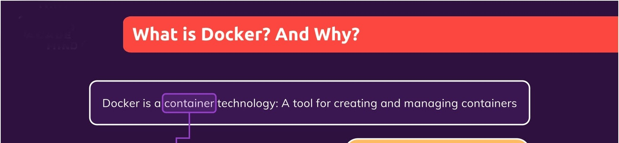


The same container always yields the exact same application and execution behavior! No matter where or by whom it might be executed.
A standardized unit of
software
Support for Containers is built into modern operating systems!
A package of code and dependencies to run that code (e.g. NodeJS code + the NodeJS runtime)
Docker simplifies the creation and management of such containers

Slide 2
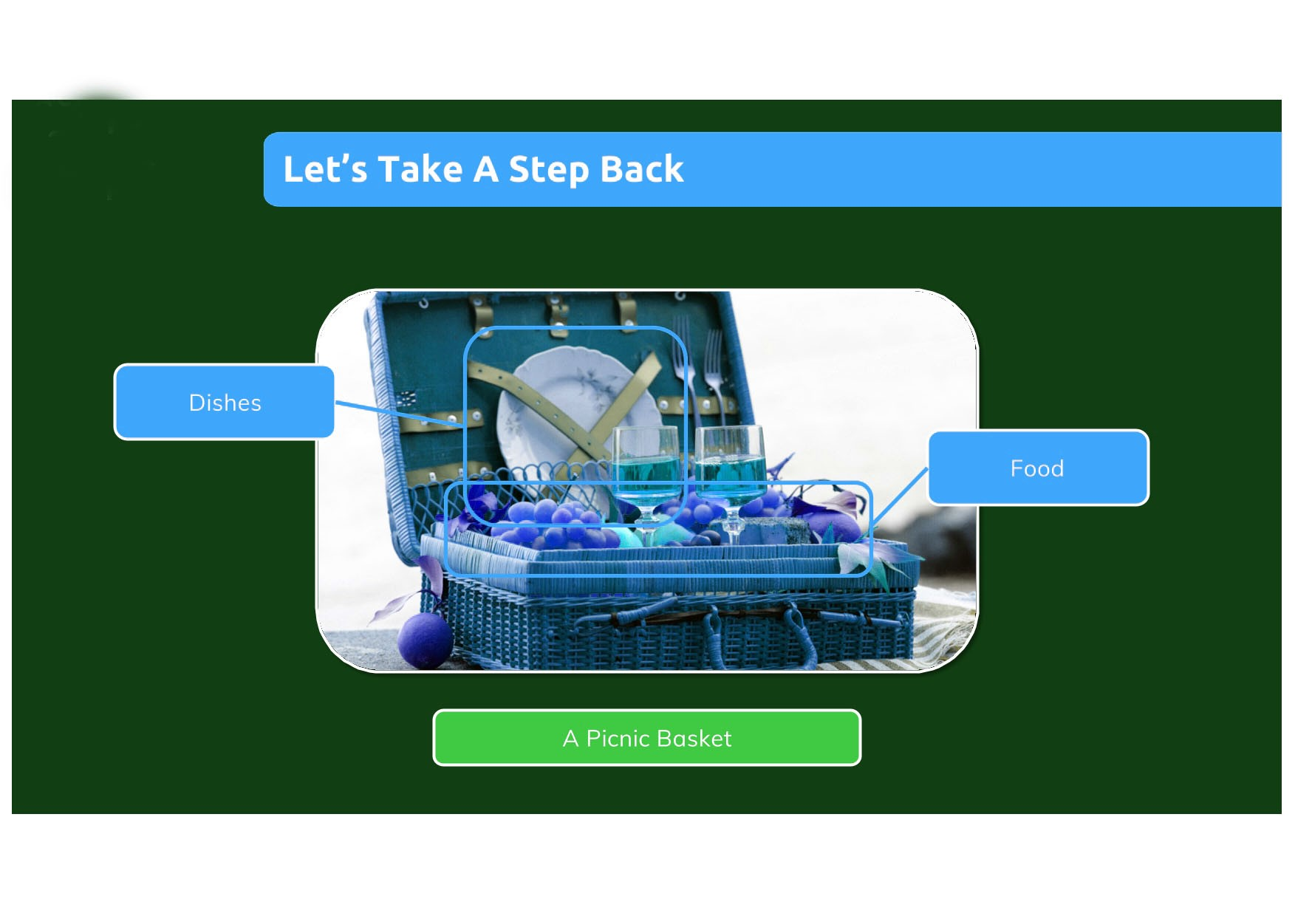

Slide 3
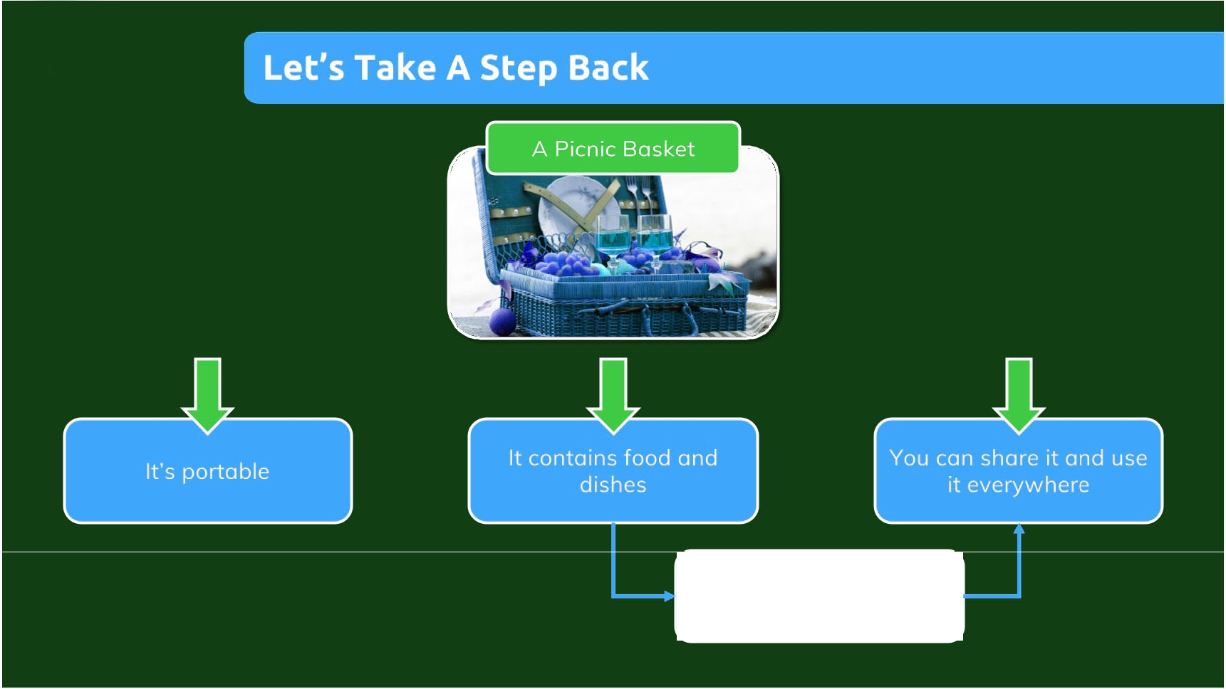
No special environment or tools are required

Slide 4
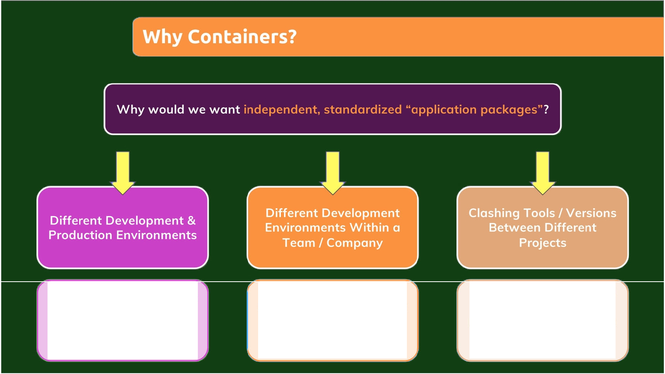
We want to build and test in exactly (!) the same environment as we later run our opp in
Every team member should have the exactly (!) same environment when working on the same project
When switching between projects, tools used in project A should not clash with tools used in project B

Slide 5
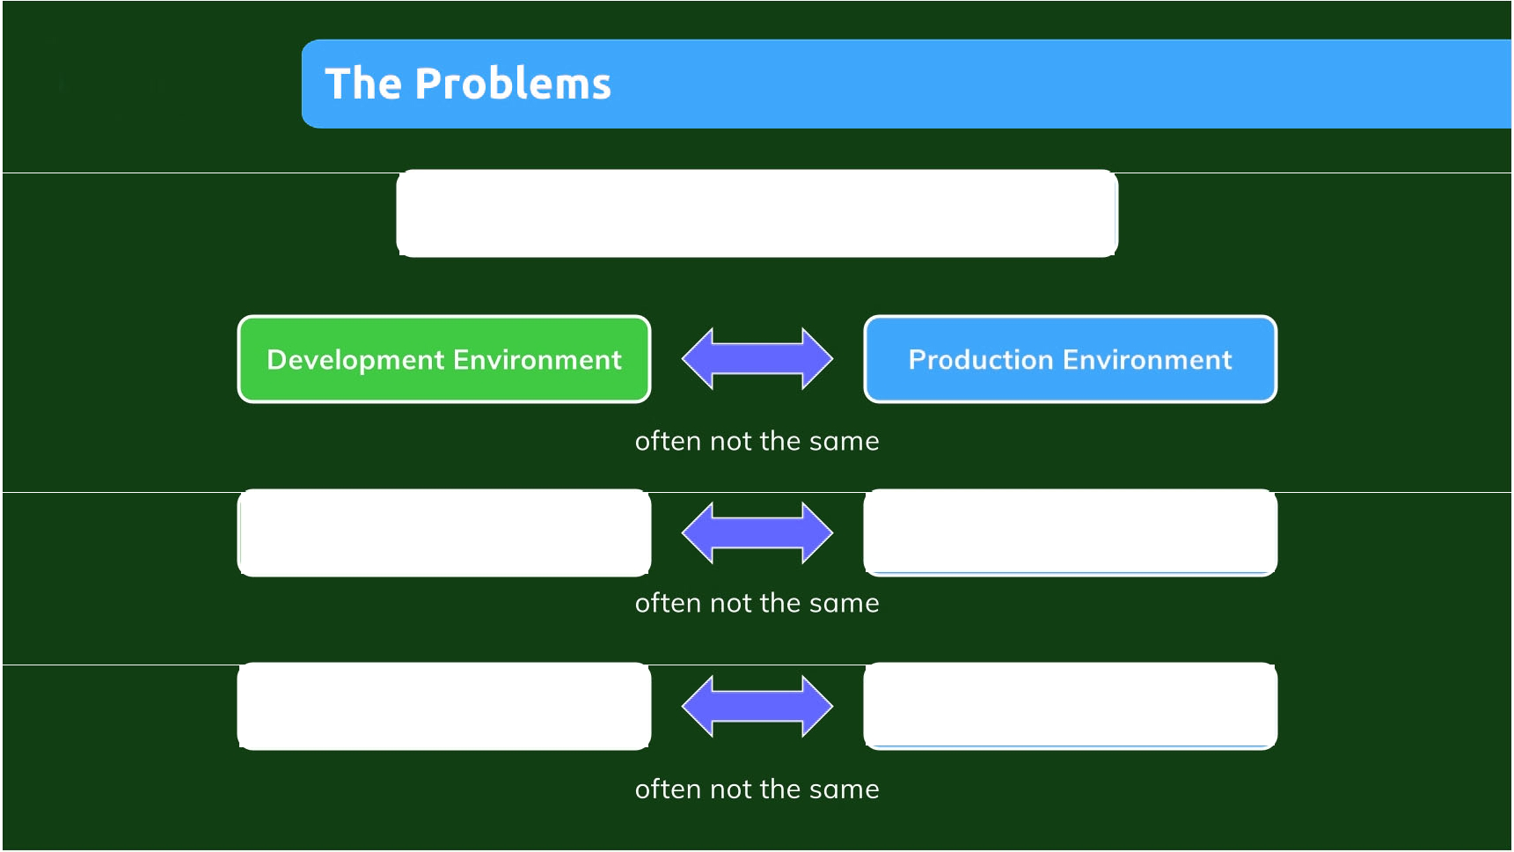
Environment: The runtimes, languages, frameworks you need for development
Development Environment
Development Environment
for Employee A
for Employee B
Tools & Libraries required
Tools & Libraries required
for Project A
for Project B

Slide 6
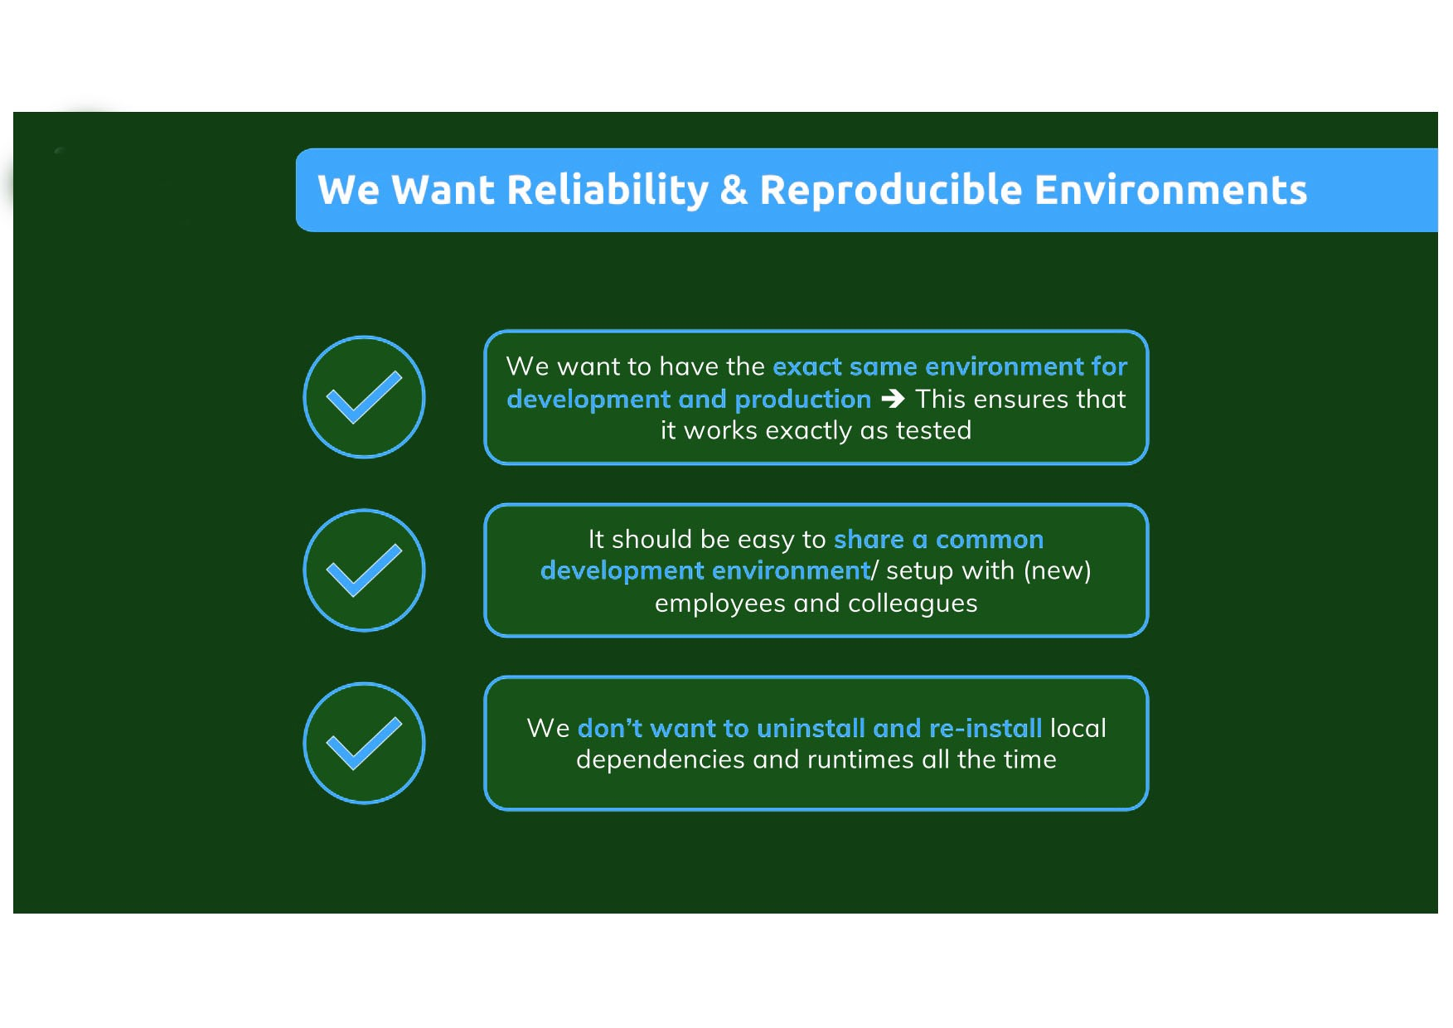

Slide 7
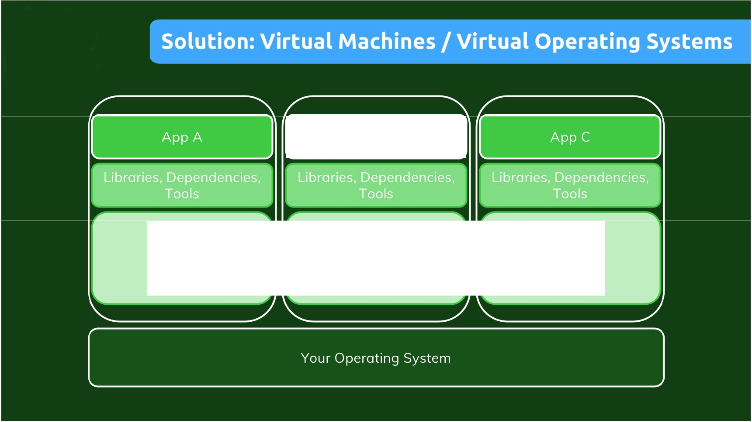
App B
Virtual OS (e.g. Linux)
Virtual OS (e.g. Linux)
Virtual OS (e.g. Linux)

Slide 8
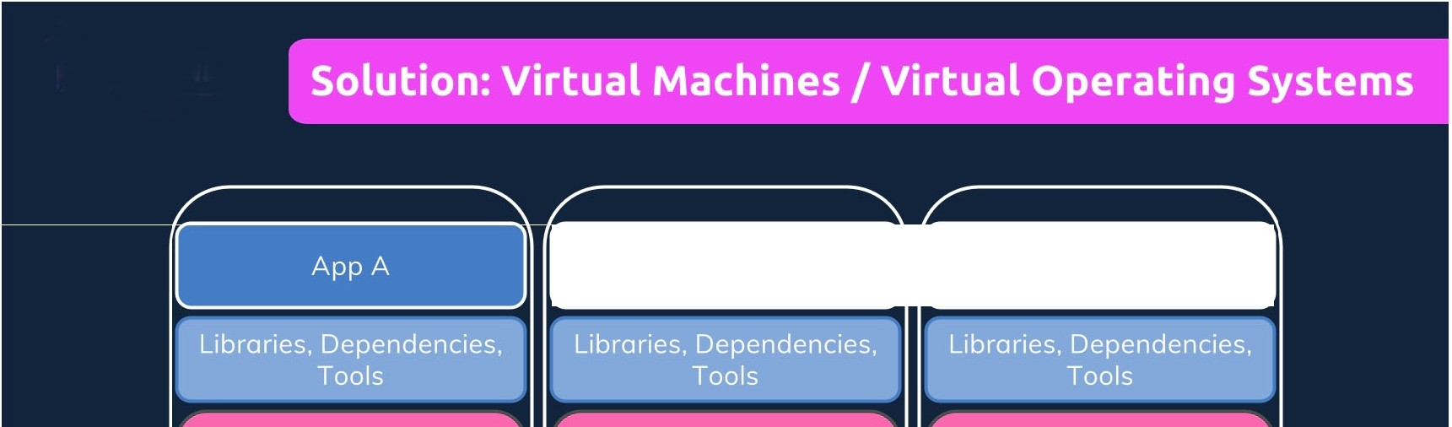
App B
App C
Virtual OS Virtual OS Virtual OS (e.g.Linux) (e.g. Linux) (e.g. Linux) Wastes a lot of space on your hard drive and tends
 | to be slow ,"I ..
,...
Your Operating System .... II"'.
.

Slide 9
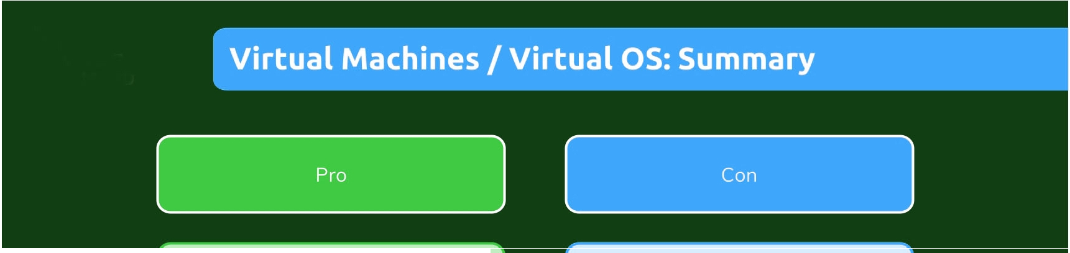
 | .,
Environment-specific configurations are possible
I I
Redundant duplication, waste of
I
Separated environments
space
"«._
,;.'
, | E ·,
I..,-
I
Performance can be slow, boot
times can be long
Reproducing on another computer/
I
nvironment configurations can be
server is possible but may still be tricky
shared and reproduced reliably
•'
''11

Slide 10
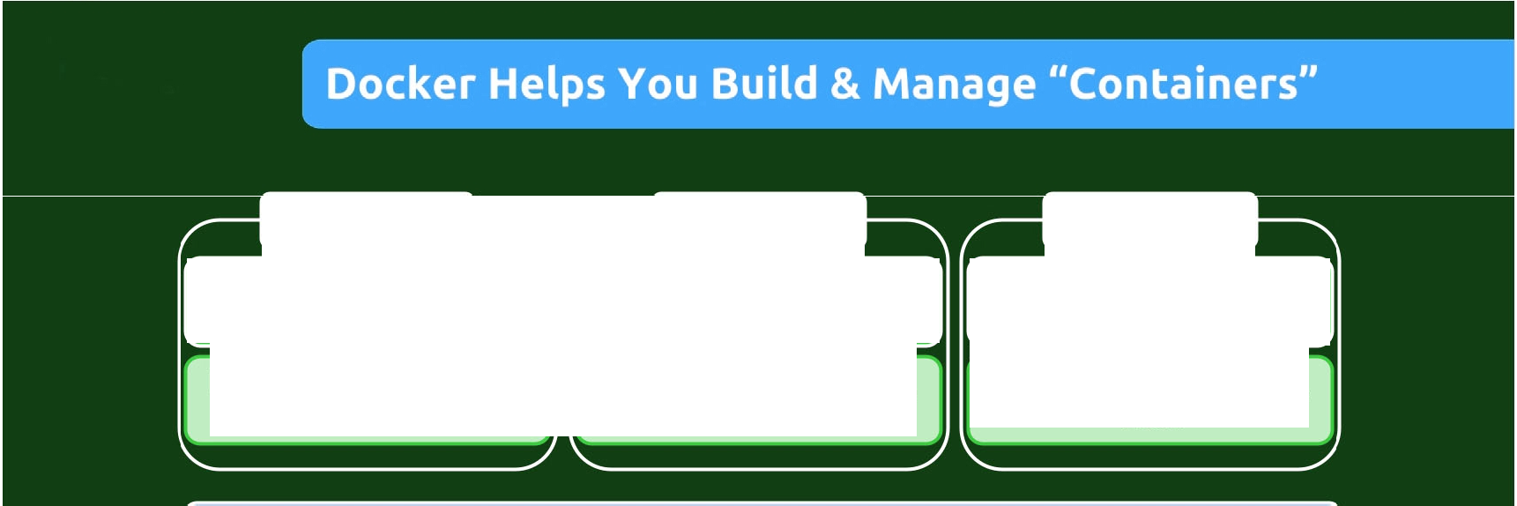


Container
Container
Container
App A
App B
App C
Libraries, Dependencies, Tools
Libraries, Dependencies, Tools
Libraries, Dependencies, Tools
Docker Engine
OS Built-in I Emulated Container Support
Your Operating System

Slide 11
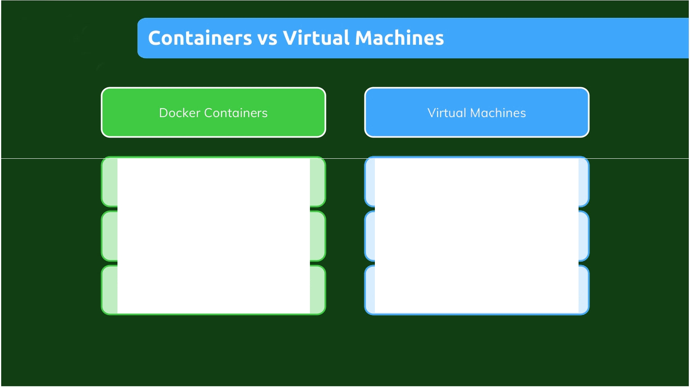
Low impact on OS, very fast, minimal disk space usage
Bigger impact on OS, slower, higher disk space usage
Sharing, re-building and distribution is easy
Sharing, re-building and distribution can be challenging
Encapsulate apps/ environments instead of "whole machines"
Encapsulate "whole machines" instead of just apps/ environments

Slide 12
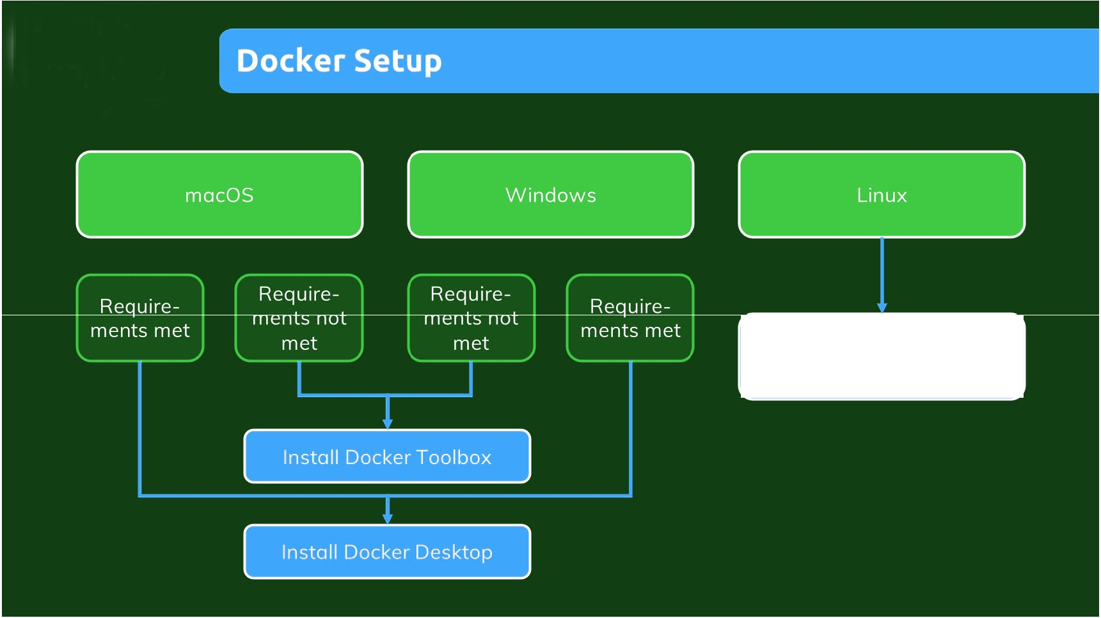
Install Docker Engine on Linux
(see attached resources)

Slide 13
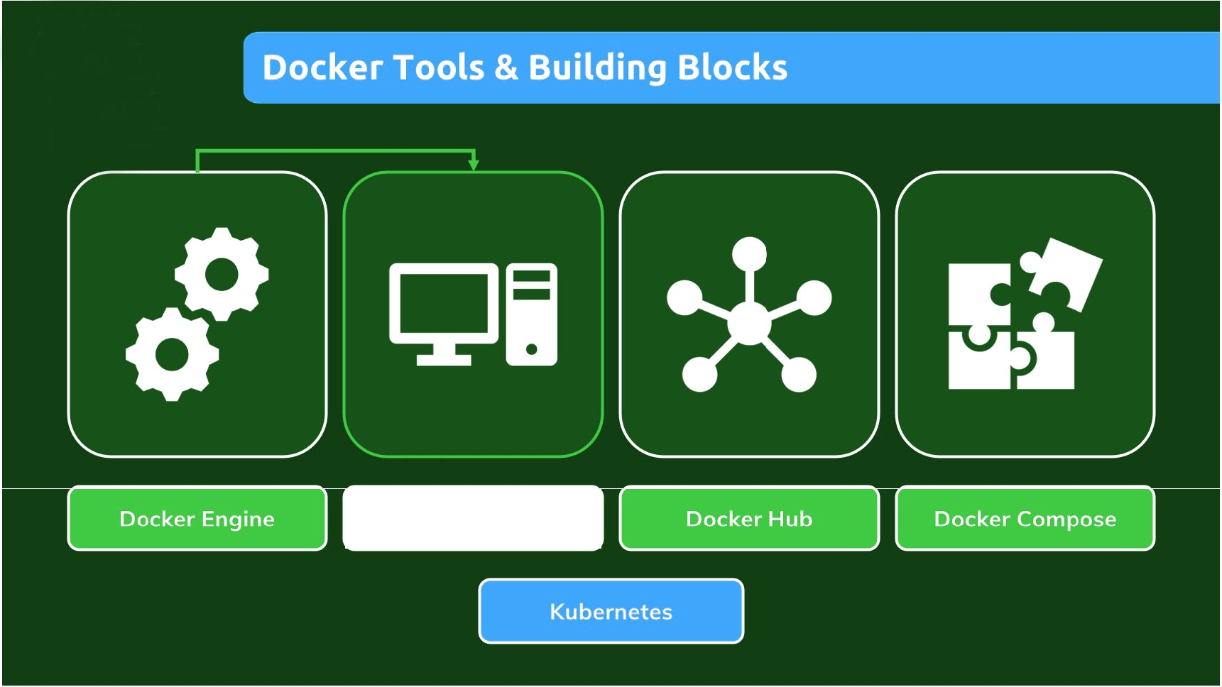
Docker Desktop (incl.
Daemon & CLI)

Slide 14
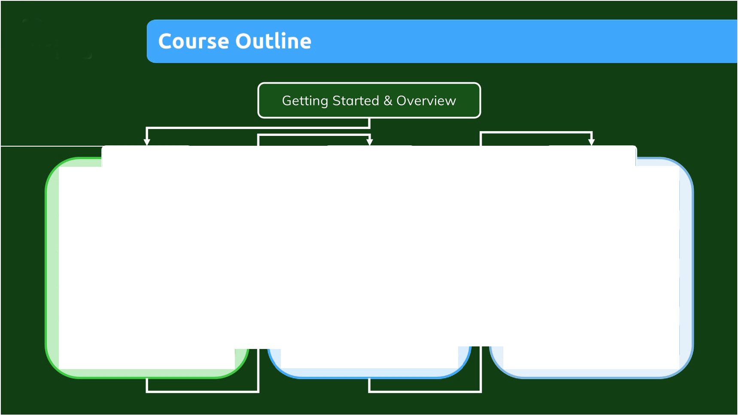

Foundation
Kubernetes
/
-
-
---
-'1
-
Kubernetes Introduction
; Images & Containers I
' '
Multi-Container Projects
& Basics
I 1
'---------- ---------
'
r---- .
-,
Using Docker-Compose
Kubernetes: Data &
1
Volumes
" D | ata & Volumes | I
I | (in Containers)
I
'
-
1'
''
I
•'^{I}
Containers" II
../
Kubernetes: Networking
(
-
-
'-
Containers &
I
Deployin Docker
Deploying a Kubernetes
I
Networking
Containers
I
Cluster
_ I

Slide 15
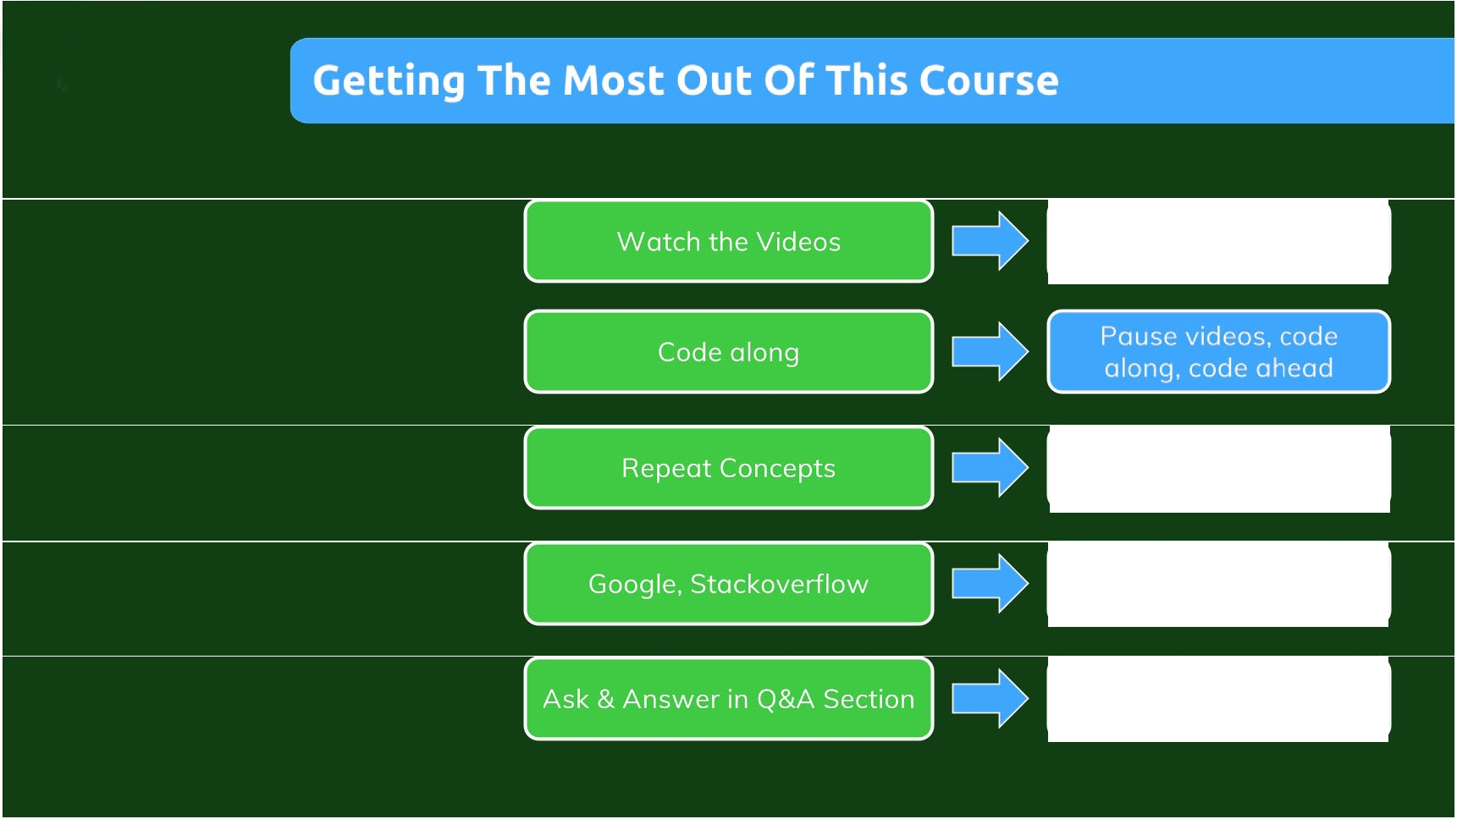
At your pace - use the video player controls
Repeat videos or sections if unclear
Search the web in case of errors
Ask and help others in the Q&A board

